Slide 1
“Title of the Project”
Phase-II Presentation
By
Student Name : USN
Student Name : USN
Under the Guidance of
Prof/Dr. Name of Guide here..
Department of Computer Science and Engineering
KLS, GIT, Belgaum
Academic Year – 2018-19

Slide 2
1. Problem Statement 2. Prior art Search – Findings 3. Final Design – Details 4. Implementation details 5. Test-Cases 6. Future Plan of Action
Table of Contents

Slide 3
Problem Statement : Two to three lines.. Indicating what objectives your project would achieve … Refined Problem statement if any… or else same as in Phase - I
Project Title

Slide 4
Brainstorm keywords to describe the invention. ... Search the patent databases. ... Expand your search beyond patent databases. ... Save all relevant results and documents. ... Know when to stop searching. Search copyright database http://copyright.gov.in US Patent Search site http://www.uspto.gov/patents-application-process/search-patents (Remove this slide after you have learnt how to do the search)
How to carryout Prior art search…

Slide 5
Example search in indian copyright site : http://copyright.gov.in Title of work – Virtual reality Result 1 : No results found Result 2 : 2- patents ( Search in US patent site) Result 3 : 1 - patent Result 4 : Indian Patent website search… Result 5 : GoogleScholar search result etc… Concluding remarks : Please mention how is your work unique and different from above findings…
Prior art – Search results

Slide 6
Add More slides… If you have more points to discuss and defend your work as unique…
Prior art – Search results

Slide 7
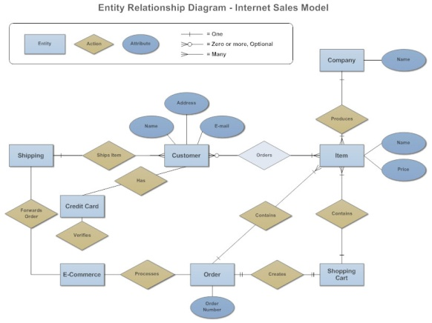
1. Final ER-Model ( ER-Diagram – If applicable )
Design Details ( Use free tools like Dia or StarUML to draw following diagrams )

Slide 8
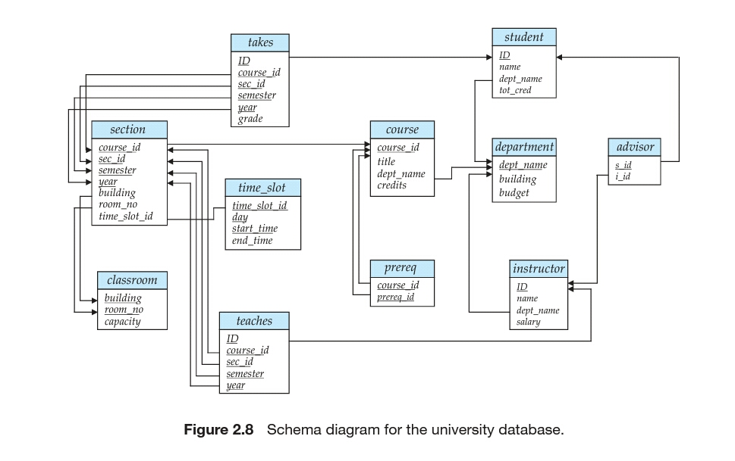
2. Schema Diagram ( Primary key, Foreign key identified)
Design Details ( Use free tools like Dia or StarUML to draw following diagrams )

Slide 9
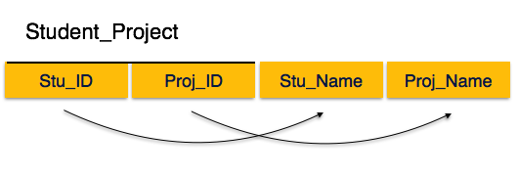
2. Normalization : List of functional dependencies of each relation and 2-NF and 3-NF verification For example, Fd1 = { Stu_ID → Stu_Name} Fd2 = { Proj_ID→Proj_Name } Primary key is {Stu_ID, Proj_ID} -- Both FDs are partial hence, this relation is not in 2NF.
Design Details

Slide 10
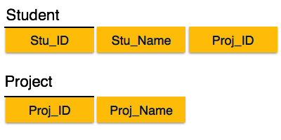
Normalized Relations are : Both are in 2NF and also in 3NF
Design Details
For each of the relations – Show that all relations are in 2NF and 3NF after identifying correct set of functional dependencies.

Slide 11
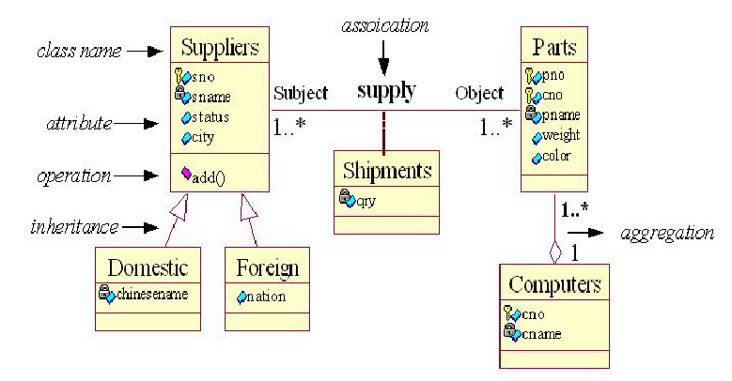
1. Class Diagram – If code is developed using OOPS
Design Details ( Use free tools like Dia or StarUML to draw following diagrams )
Software Design - Breaking down customer requirements into functional blocks….

Slide 12
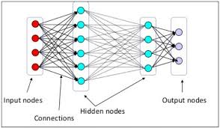
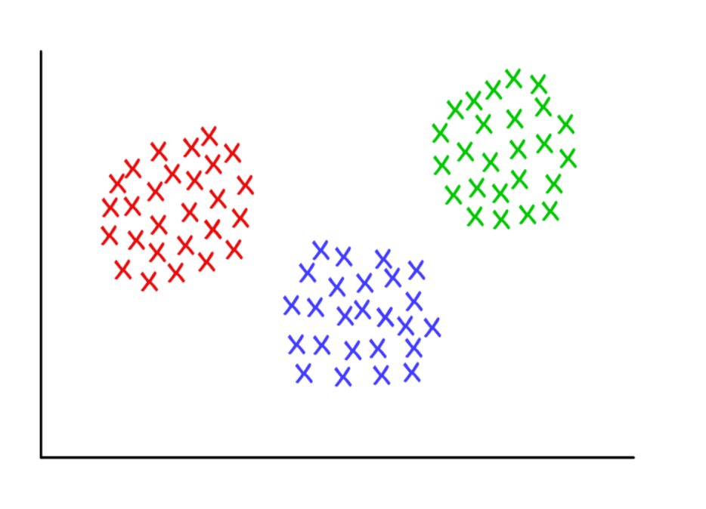
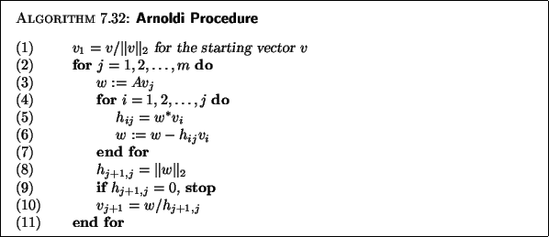
Any – Algorithm Used ( For, Example Neural Network : BackPropagation or RBF or Clustering algorithm like k-means etc… )
Design Details ( Use free tools like Dia or StarUML to draw following diagrams )
Software Design - Breaking down customer requirements into functional blocks….

Slide 13
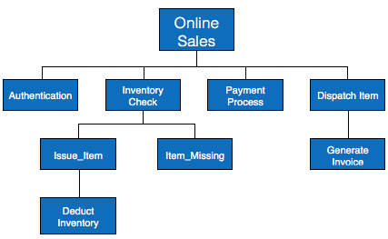
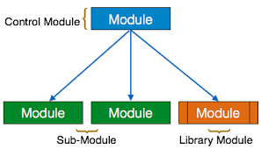
A module is the one that, Encapsulates code and data to implement a particular functionality. Has an interface that lets clients to access its functionality in an uniform manner. Is easily pluggable with another module that expects its interface. Is usually packaged in a single unit so that it can be easily deployed. (Examples )
Design Details ( Use free tools like Dia or StarUML to draw following diagrams )
Software Design - Breaking down customer requirements into functional blocks….

Slide 14
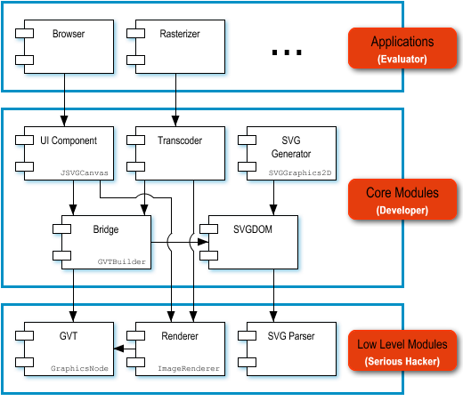
Modules and their interaction( Use free tools like Dia or StarUML to draw following diagrams )

Slide 15
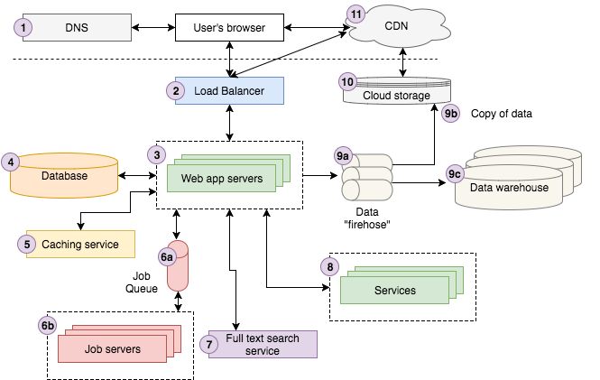
Software - Architecture( Refined and Finalized)

Slide 16
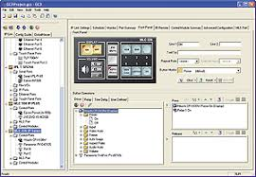
Final GUI – Design details
Design Details ( Use some free tools… )
GUI Design - Planned User Interface Design…. ( One or Two UI samples… )

Slide 17
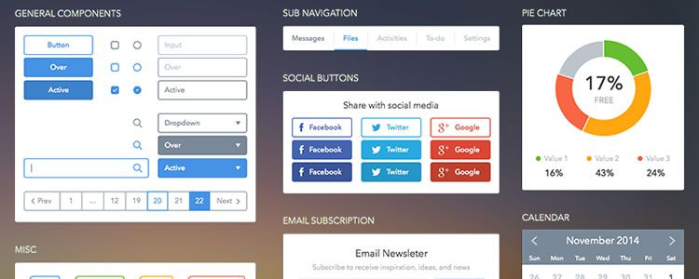
Final GUI – Design details
Design Details ( Use some free tools… )
GUI Design - Planned User Interface Design…. ( All UI Screens… )

Slide 18
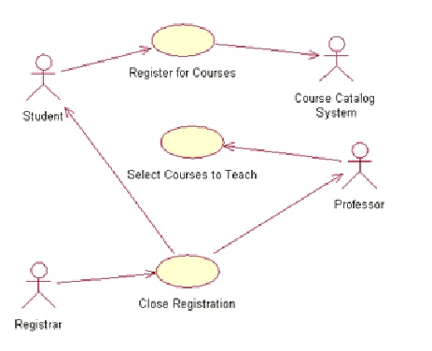
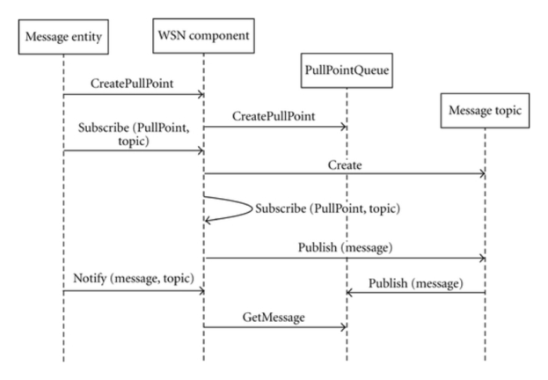
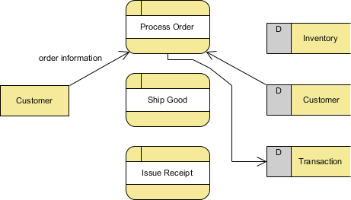
1. Final Case Diagrams ( All ) 2. Sequence Diagrams (All) 3. Data flow diagrams ( All, if applicable) 4. Any other… as applicable to your project
Other Software Artifacts ( Refined final diagrams )

Slide 19
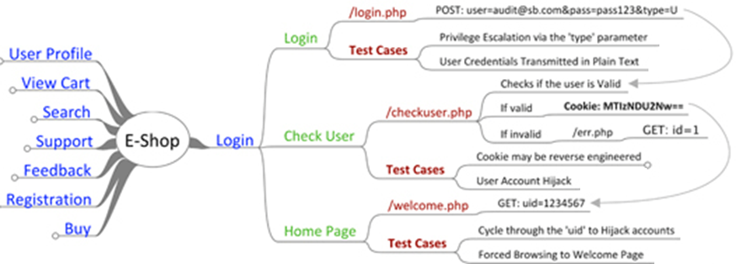
Test- Cases Identified and Tested ( show 2-3 test cases and the result of test… )

Slide 20
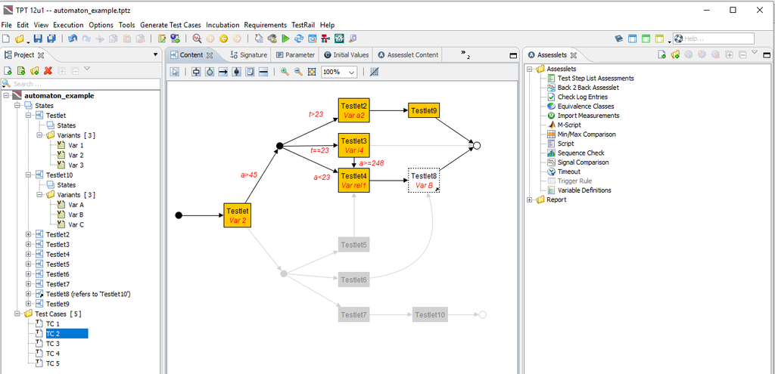
Test- Cases Identified and Tested ( 2-3 test cases…)

Slide 21
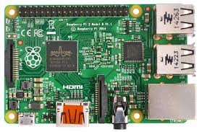
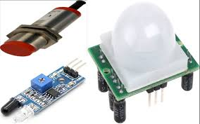
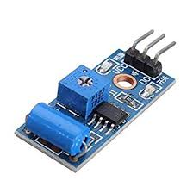
Rasbery – PI, Aurdino board or Any others – Specifications Show the images of the same.. Here… Sensors if any -- Technical Specifications Show the images here….
Hardware Projects (If Applicable )

Slide 22
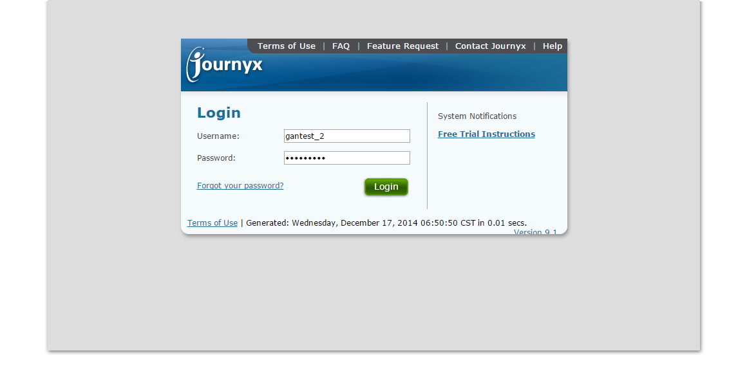
Show actual Screen Shots-Designed and Tested
Software - Projects

Slide 23
1. Problem Statement & Title Finalized - Yes/No 2. Design – Database, Class/Module, GUI Complete/Incomplete 3. Code – Modules Developed Done/PartlyDone/Yet to Begin 4. Test-Cases Identified Identified/Tested/Not Ready 5. Project Report writing Begun/Yet to start In the Gantt Chart -- Show 1. Literature/Product Survey 2. Problem Statement and Requirement Specs 3. Design – Details 4. Identify and Design Implementation modules 5. Coding and Testing 6. Report Writing Refer to next slide for Gantt Chart diagram…
Project Work Progress

Slide 24
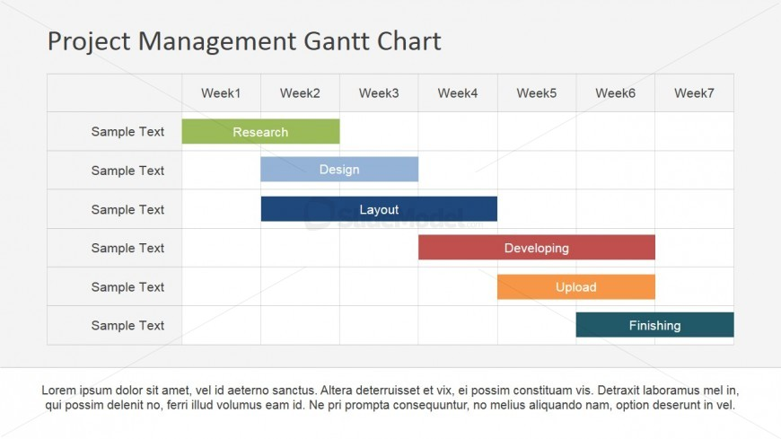

Show the final Diagram…. Check the parts that are complete…. As shown below
Project Work Progress ( Use a tool to draw Gantt chart for your project )

Slide 25
References
Books ( Author/s,title, publisher, year)
E-resources (Author/s, url, date of reference)
Journal Papers ( Authors, Title,Publisher, year)
Include atleast – 10 References.

Slide 26
Questions ?

